Slide 1

Oxfam and WASH
By Praphulla Shrestha, WASH Coordinator, and Sophie Ford, Humanitarian Program Coordinator, Oxfam Australia

Slide 2
Can you guess the acronym?
WASH
Water, Sanitation and Hygiene
EWASH
Emergency Water, Sanitation and Hygiene
PHP
Public Health Promotion
PHE
Public Health Engineering

Slide 3
Oxfam is universally recognised as a leading organisation in Water, Sanitation and Hygiene (WASH) and
Emergency Water, Sanitation and Hygiene (EWASH).
1962: Drilling wells for Palestinian refugees in Jordan
1980s: Supplying water to IDP camps in Ethiopia
1980s: Development of “T” Tanks
1990s: Development of “Oxfam bucket”- 14 Litre water container
1997: Assisted development of technical standards for humanitarian responses (SPHERE)
2004: Leading member of interagency WASH cluster
2005 onwards: New research and interventions
HISTORY OF Oxfam & WASH
Notes:
WASH =Water, Sanitation and Hygiene
EWASH = Emergency Water, Sanitation and Hygiene

Slide 4

WHY is WASH important?
Public health diseases in emergencies
Disease | Cause
Diarrhoea, dysentery, cholera | Water borne (contaminated water)
Infectious skin and eye diseases | Lack of water
Malaria, dengue, river blindness | Water- related and vector borne (breed in water)
Schistosomiasis, guinea worm | Water based life forms
Notes:
Unless adequate water and sanitation services are quickly provided to emergency-affected children and their families, disease and death will follow.

Slide 5
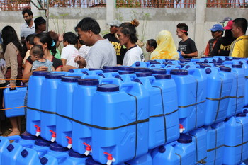
EMERGENCY WASH – How?
Our aim: Saving lives!
We reduce the risk of WASH-related infectious diseases by ensuring affected population have access to:
Sufficient amounts of safe water (during emergencies, 15L per person per day)*
Adequate sanitation facilities
Essential hygiene materials
The means, knowledge and understanding to use these public health resources adequately
* The SPHERE handbook is used to guide water quantity and quality for distribution.

Slide 6
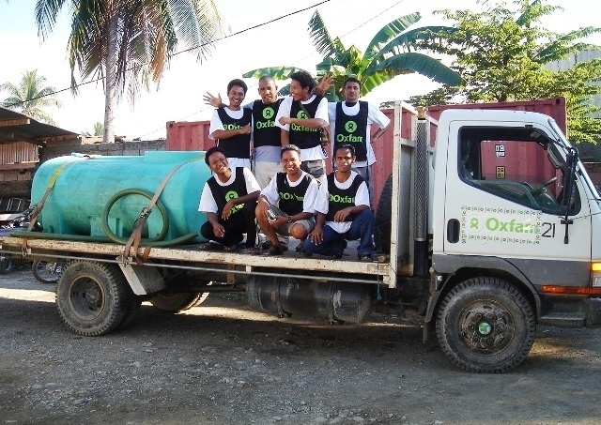
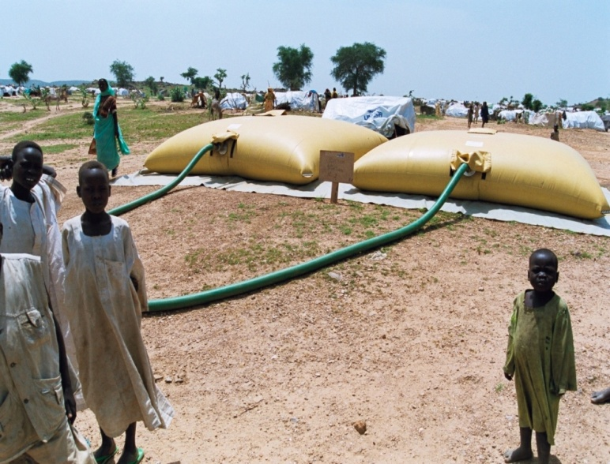
WATER IN EMERGENCIES
We ensure access to safe, clean water supply
Water bladders
Hand dug wells
Bore holes
Hand pumps
Gravity system
Rain water harvesting
Water trucking
Notes:
Water bladders are a type of water tank made of rubber, PVC and other synthetic materials, which are normally foldable. Engineers/Technicians can easily unfold them, fill with them clean water and connect them to water taps. To fill the bladder, methods like water trucking supported by borehole or hand dug wells or other water sources are used. Any disinfection needed can be done in the bladder itself. The bladder tank comes in ranges of sizes, 2000, 4000, 5000, 10,000 and 20,000 litres. 5,000 and 10, 000 are most common variations.
Hand dug wells are holes made in the earth. People dig them and line the walls to make them strong. Water is collected from the well using a bucket and rope, hand pumps or electrical pumps. They can normally support up to 100 families.
Bore holes are also holes made in the earth. They are normally small in diameter (4 to 6 inches) and deeper than dug wells – normally 40 meter or more. The depth depends upon where the ground water aquifer (layer containing underground water) lies. A drilling machine is used to drill boreholes, and ranges of pipes and filters are placed into the drilled borehole once the water level is reached. It is then cleaned and water is pumped out using electric or hand pumps. It can support many families as the capacity can be as high as 1,000 litres per minute.
Hand pumps are devices to pump water out of borehole or dug well from inside the earth to the surface of the earth. Hand pump capacity ranges from 0.33 to 1 litre per second.
Gravity system is a method of bringing water from water sources situated in hills to community situated in lower lands. It does not need external energy to draw the water, gravity does the job! It is cheaper and requires less maintenance. Capacity depends upon the water source capacity.
Rain water harvesting is a system where water from rain is collected in tanks and distributed for drinking. It is relatively cheaper and faster to activate during emergency responses. Capacity mostly depends upon rainfall, catchment size and collection tank size.
Water trucking is a method of transporting water from water sources to bladders or tanks set near tap posts or distribution points. In this system, water from the source is placed in a clean water tank truck and physically transported located far from the source.

Slide 7
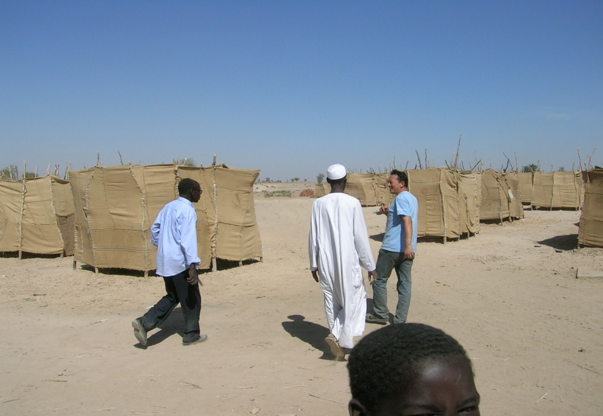
SANITATION IN EMERGENCIES
Sanitation provision
Excreta disposal – Disposing of human waste, via latrines in refugee and internally displaced peoples camps, schools, health centres and households
Solid waste management – Managing waste such as plastics, papers, glass, rubbish including human and animal faeces
Drainage - Stagnant water from flooding or cyclones
Vector control - Action against mosquitoes and flies
Notes:
Excreta disposal is very important. One way to ensure excreta disposal is managed is to install temporary latrines during the early stages of response; for example, temporary latrine at refugee and IDP camps, temporary latrine at schools and so on. The latrine design varies depending upon the context.
Solid waste management refers to the management of waste such as plastics, papers, glass, rubbish including human and animal faeces.
Drainage refers to stagnant water as a result of the effects of flooding or cyclones.
Vector control refers to the control of flies, mosquitoes and other insects in an emergency situation.

Slide 8
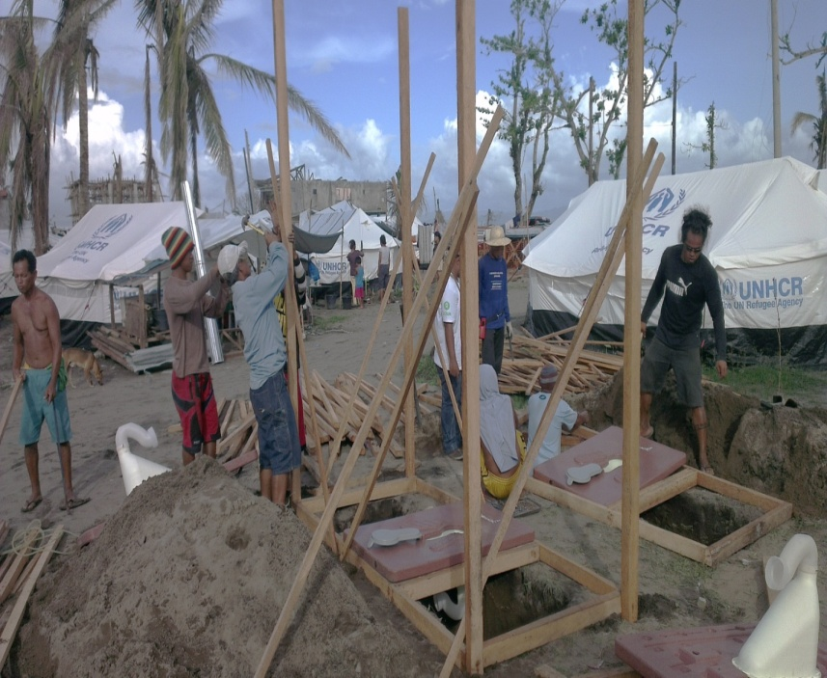
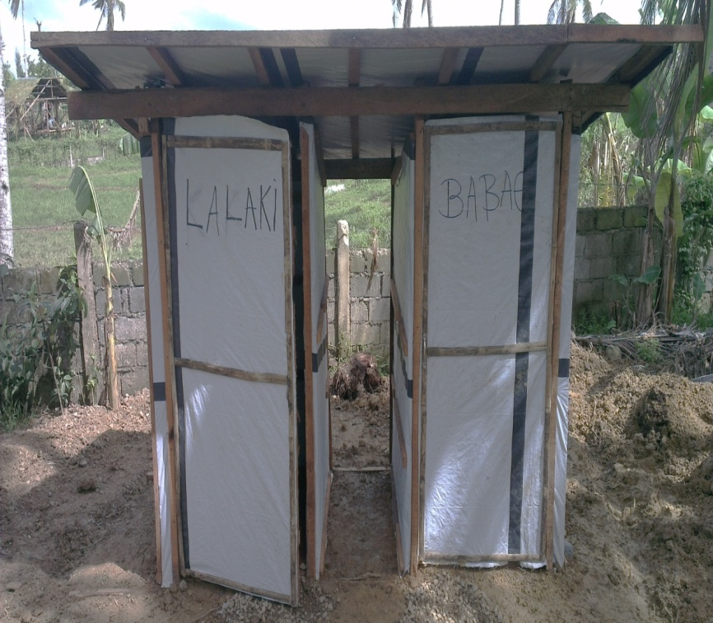
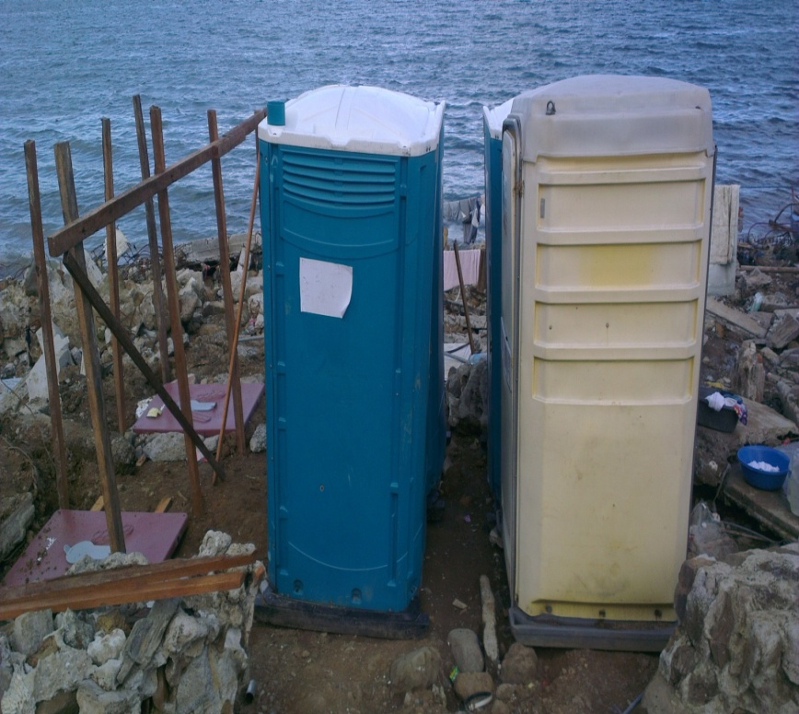
Temporary Latrines
Notes:
Temporary latrine are constructed in a number of ways. Here are 3 examples:
From local wood, cement, sand , stone, brick, timber, nail, toilet pan+ water seal and tarpaulin sheets.
Some are readymade – for example “porta loo” / “portapoos”. This comes readymade; and engineers dig a pit and line it where needed.

Slide 9
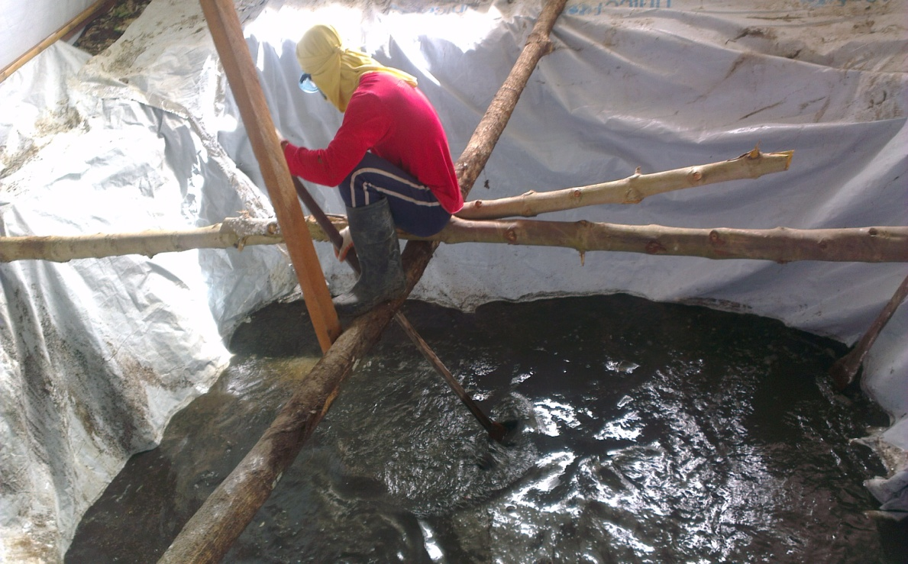
Sludge Treatment
Notes:
Sludge treatment is a very important issue and Oxfam has an innovative method for dealing with sludge. Sludge refers to the effluent from septic tank or toilets.
To treat it, the effluent is first collected in a tank dug into the ground and mixed with chemicals (here, lime) manually. Then it is allowed to settle to allow solids to sediment at the bottom of tank.

Slide 10
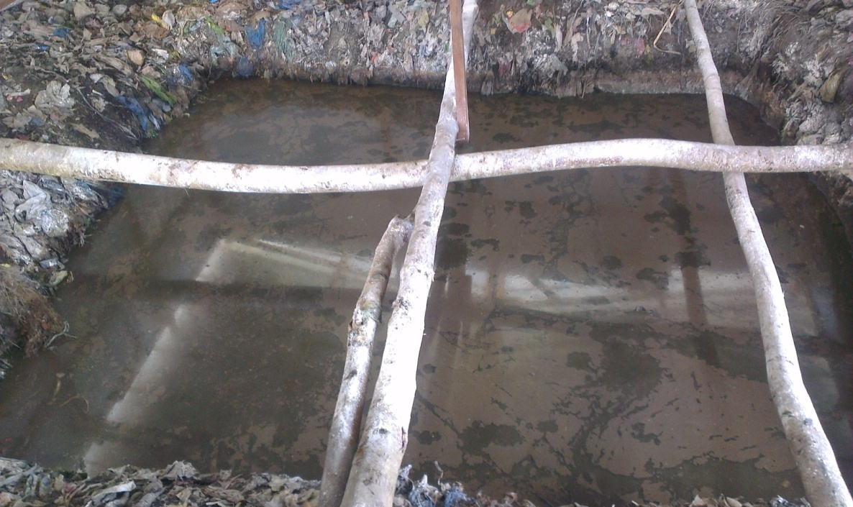
Notes:
The liquid at top of the tank is removed to….

Slide 11
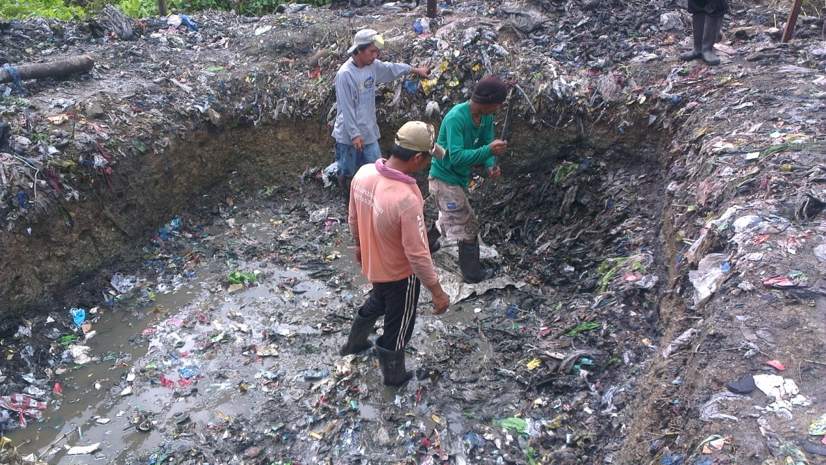
Notes:
…another tank in the ground, which gets evaporated and seeps into the ground.
The solid that has settled in the original tank is then dried in sun and used as compost for vegetable farms

Slide 12
Case study- Peepoo bags
Haiti 2010
After the Haiti earthquake, thousands of people were left without
sanitation, often camping in tight, compacted and concreted areas
where no latrines could be dug
Oxfam worked with Swedish company Peepoople
Trialed biodegradable bags as a toilet substitute
Used bags collected in central waste bin
YouTube video on Peepoo bags: http://youtu.be/7IHLk5SmFKc

Slide 13
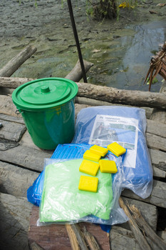
Public Health Promotion
Public Health Promoters (PHP) focus on helping communities
prevent diseases related to WASH. What do they do?
1. Distribution of hygiene kits and water kits
2. Communication and information dissemination
on things like:
Importance of hand washing
How to keep water clean
How to dispose of human waste
3. Training on use and maintenance of latrines
4. Vector control and malaria prevention activities
Fly and mosquito control chemical sprays;
Campaign to clean up after animal waste
Destruction of mosquito breeding grounds and ponds
Mosquito net distribution
Education program on vector and mosquito control

Slide 14
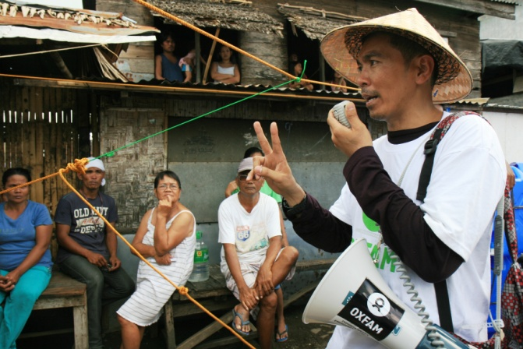
Public Health Promotion
Oxfam has an innovative approach to public health
promotion
Communicating in different ways to
influence behaviour change
  Radio and songs
  Street theatre
  Puppet shows
  Interactive text messaging
Development of interactive e-learning module on information, education and communication (IEC) in WASH emergencies
Partnerships with Universities (including Monash University in Australia, University of Surrey in the UK and the University of Barcelona in Spain.)

Slide 15
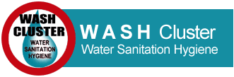
Coordination of WASH
Oxfam is an active member of WASH cluster
In emergency responses Oxfam will coordinate with other actors to
ensure no overlap of WASH activities.
The WASH Cluster is also an opportunity to influence national WASH sector.
The WASH cluster is led by UNICEF (multilateral aid).

Slide 16
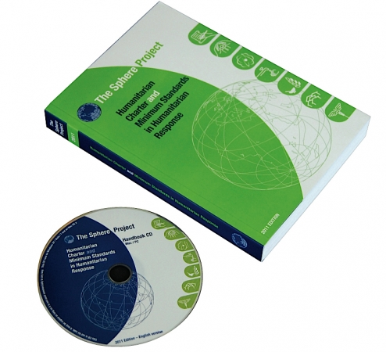
Key Guiding Principles
SPHERE
The Sphere Project and handbook sets out the
technical standards for WASH that cover:
Water supply
Sanitation
Hygiene promotion
Excreta disposal
Vector control
Drainage
Notes:
The full content of the Handbook is also available online as a micro-website at SphereHandbook.org

